Slide 1
Jeunes Chefs Rôtisseurs Competition
Guideline for staging a competition
November 2018

Slide 2
Table of Content
Purpose
International Rules
Pre Competition National
Competition National
Post Competition National

Slide 3
Purpose

Slide 4
Purpose
This Presentation is designed to assist all those countries wishing to send a competitor to the International JCR Competition, to provide the best advantage to the competitor.
Rules for International JCR Competition
https://competitions.chainedesrotisseurs.com/base.php?code=17
It is important that your National Team try to replicate the International rules as much as possible to ensure your competitor feels prepared.

Slide 5
International Rules

Slide 6
International Rules
The International Manual covers the following in detail:
General Information
Hosting responsibilities
Competitor and Home Bailliage responsibilities
The Jury
The Competition
Black Box
Judging Criteria
Results and Awards
Form Templates

Slide 7
Pre Competition - National

Slide 8
Pre Competition - National
Who is responsible for your competition? They should be familiar with the international rules.
National level – Conseiller Culinaire
Regional or Local Level – Vice -Conseiller Culinaire
How much, on average does a national competition cost?
Create a budget
National Costs
Transportation
Black box
Meals
Find sponsors (e.g. venue, black box, accommodation)
Enlist local CdR members to assist

Slide 9
Pre Competition - National
What is the minimum number of competitors required?
National 4-10?
How many judges?
Kitchen - 2 min
Tasting - 3 professional, 1 non professional minimum
What type of facility is needed to conduct a successful competition?
Culinary School
Catering Kitchen
Rented demo kitchens

Slide 10
Pre Competition - National
What is needed in the kitchen?
All units must have identical heating source (gas, electric, induction)
Same stove
Same oven
Same prep area
Standup freezer with shelf for each competitor(ideal)
Water and Clean up space

Slide 11
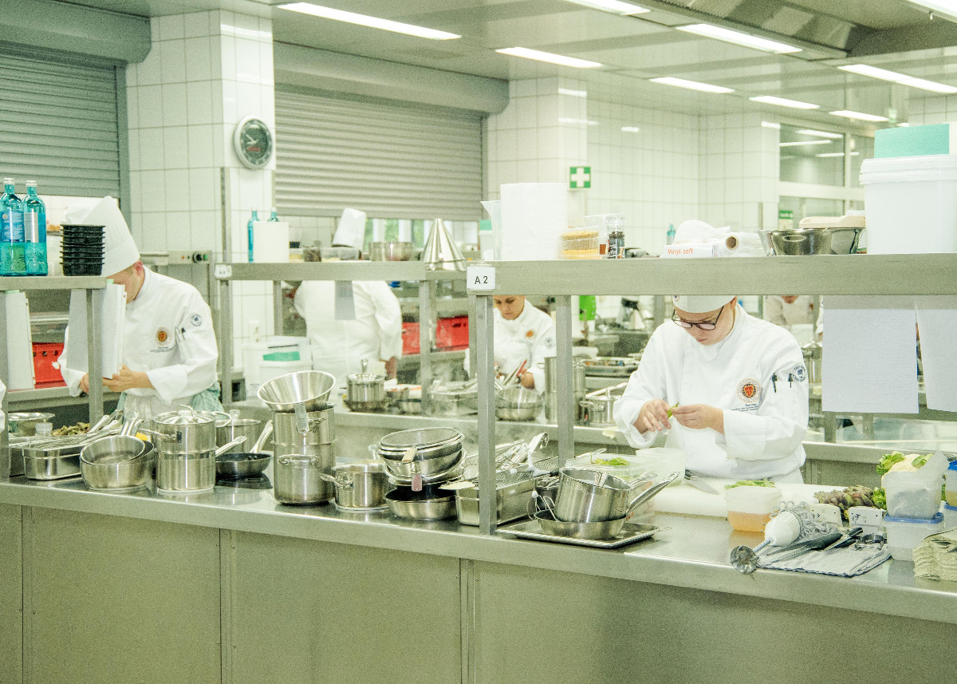
Pre Competition - National
Frankfurt 2017 Competition – Prep and demo kitchen

Slide 12
Pre Competition - National
How far in advance should you start preparing for competition?
1 yr
pin down date and the facility
start recruiting sponsors if required
Collect information from regional competitions as they happen. If there are no regional competitions then start the discussion with country professional members to nominate appropriate candidates.

Slide 13
Pre Competition - National
6 months
reserve a competition space for winner at international (national only)
order ribbons for winners from International Headquarters
Communicate with professional members and find out progress of candidates.
Meet with facility manager and confirm venue and staff assistance if required
Ensure accommodation for out of town competitors is arranged.
Recruit a CdR member to assist with managing the chefs, (pick up, delivery to competition)

Slide 14
Pre Competition - National
1 month
confirm all candidates eligibility.
communicate details of the competition to competitors
design the black box
finalize judges and communicate details of competition
ensure certificates and ribbons have been received from International Headquarters
finalize details of awards ceremonies (notice to local CdR members if they are invited) catering, sponsor attendance.
Prepare all forms required for judging.

Slide 15
Pre Competition - National
1 week
confirm venue is ready
meet with judges and any assistants and go over forms and your expectations.
Ensure black box ingredients and common table are purchased and will be delivered minimum 2 days prior to competition.
Confirm accommodation of competitors if necessary
Ensure adequate stationary available (note pads, forms, pencils, pens, computer and printer for writing menus etc.)

Slide 16
Pre Competition - National
1 day
If possible meet with the chefs for a kitchen tour and station draw
Set up venue for competition
Prepare required number of black boxes
Ensure common table is complete
Set up writing room
Set up tasting judges room
Confirm all judges
Confirm catering for judges
Confirm catering for awards event

Slide 17
Competition Day

Slide 18
Competition Day
The following timing is dependent on the number of competitors and space available. International usually has 22-24 competitors so it has a morning flight and an afternoon flight. Each flight will be divided up into two or three groups. International competitions run 12-14 hours.
Things to consider
Catering for chefs on arrival
Catering for chefs post competition
If more than one group, ensure groups are separated prior to menu writing. Do you have space to separate?

Slide 19
Competition Day
-1 ½ hour
Arrive at venue with kitchen judges and committee
Ensure set up in kitchen complete
Check all stations to ensure stoves and ovens are working
Assemble kitchen judges and assistants and describe the flow of the day.
- 1 hour
Chefs arrived
15 minute kitchen tour (ideally this should be done the night before if competitors all available) Questions only addressed to kitchen supervisor. Station draw if not done the night before.
Kitchen Supervisor checks competitors’ equipment and remove prohibited equipment.
Confirm writing room ready with sample black box and menu forms

Slide 20
Competition Day
0 hour
chefs enter the writing room
black box unveiled along with written common table ingredients
chefs given 30 minutes to complete writing menu
if chefs finished early they must remain in writing room till time expires.
30 min
chefs hand in menus and proceed to their assigned kitchen stations
chefs begin to cook
Menus in other than English are translated, then typed on menu forms for jury

Slide 21
Competition Day
2h 30 min
tasting judges arrive
Assemble tasting judges and describe the flow of the day as well as your expectations
3h 30 min
first course due and sent to tasting room (for international competition, 3 plates to judges, 1 to photo table)
tasting judges have 13 minutes to complete the judging. They will not confer with each other until all have written an initial score. Alteration of initial score may only be changed by 5% after discussion.
Kitchen helpers remove dishes
3h 45min
second course due and sent to tasting room
4h
final course due and sent to tasting room

Slide 22
Competition Day
Competitors have 30 min to clean and return their station to its original condition. They must ensure that all equipment used is also cleaned. Competitors must remain in kitchen until released by Kitchen Supervisor.
Following the competition, it is important that the competitors have the ability to view all competition plates and that the judges provide constructive feedback.

Slide 23
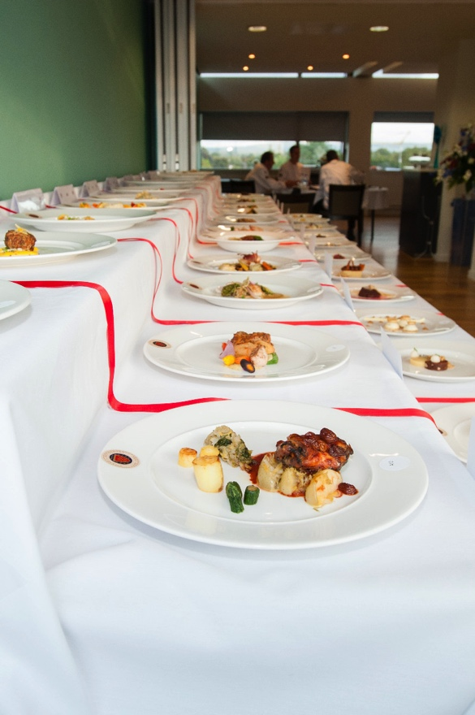
Competition Day
Manchester 2016
Final plating display

Slide 24
Competition Day
If the award ceremony is immediately following, then preparation of awards should be done during the competition in the same room as the competitors plates.
Thank the competitors
Thank the kitchen and tasting judges
Thank any volunteers that assisted
Recognize the venue and their staff that assisted
Recognize the sponsors
First award should be the kitchen award if having
Third place
Second place
First place
What are the next steps? International?

Slide 25
Post Competition National

Slide 26
Post Competition National
This is a good opportunity to assess the success of your competition and how to assist your winner with ever advantage possible to prepare for the next competition.
Write a report
When?
As soon as possible (within one week)

Slide 27
Post Competition National
What to include?
Competitors names and establishment
Winners
Kitchen judges and their establishments
Tasting judges and their establishments
Venue
Positives/negatives
Will you use this venue again?
Is there anything that would need to be changed?

Slide 28
Post Competition National
What to include? cont.
Attach budget and expenses
Number of assistance used/required to improve
Problems
Solutions to improve the competition
Black box contents
Include photos
Press release if you want
Competition summary for national newsletter
Post to website
Keep this in your Bailliage records for future competitions.

Slide 29
Post Competition National
Competitor follow-up
Assign a mentor to winning competitor (last years winner is a good resource and a Maître Rotisseur within his Bailliage)
Provide the winner with the opportunity to do 3-5 more black box trials prior to their next competition with different CdR professionals so that they gain experience of unfamiliar environments, hone their equipment and get the benefit of critique from revered chefs in the industry
Provide them with opportunities to improve on areas they are least skilled at, eg. Pastry , plating etc
Maintain up to date contact information for the winner.

Slide 30
Post Competition National
Begin the registration process for their next competition.
Make the application
supply any required fees
Ensure arrangements for cost of transportation have been done
If the competitor does not speak English, find them a translator for their international competition. Translator must read and write English and be able to accompany them to International.
Provide them a copy of the International rules
Provide them the opportunity to contact you when needed regarding competition issues.

Slide 31
Forms Available Online
Jury Application
Competitor Application
Accommodation Application – Coming soon
Competitor Check list
Medal Application form
New Scoring System Guidelines
New International Chaine Evaluation
Kitchen Judge Form
Kitchen Supervisor Time Fault Sheet
Scoring Tally Sheet

Slide 32
Jeunes Chefs Rôtisseurs Competition
Guideline for staging a competition
November 2018

